Slide 1

Data Modeling Using the
Entity-Relationship (ER) Model

Slide 2
Overview of Database Design Process
Example Database Application (COMPANY)
ER Model Concepts
Entities and Attributes
2

Slide 3
Overview of Database Design Process
Two main activities:
Database design
Applications design
Focus in this presentation on database design
To design the conceptual schema for a database application
Applications design focuses on the programs and interfaces that access the database
Generally considered part of software engineering
3

Slide 4
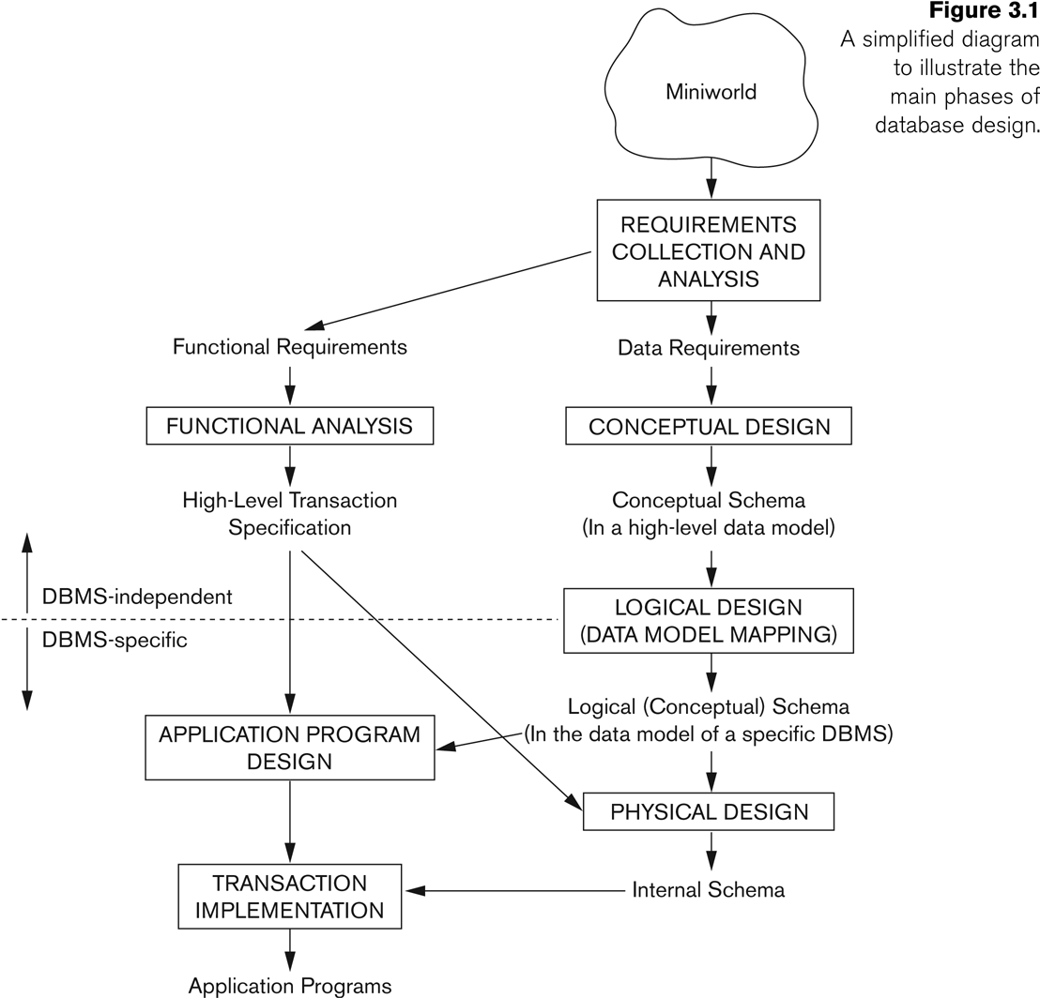
Overview of Database Design Process
4

Slide 5
Database Design
Before we look at how to create and use a database we’ll look at how to design one
Need to consider
What tables, keys, and constraints are needed?
What is the database going to be used for?
Conceptual design
Build a model independent of the choice of DBMS
Logical design
Create the database in a given DBMS
Physical design
How the database is stored in hardware

Slide 6
ERM and ERD
Entity-Relationship Data Model (ERM)
is a detailed, logical representation of the data for an organization or for a business area.
Entity-Relationship Diagram (ERD)
is a graphical representation of a Entity- Relationship Model.
6

Slide 7
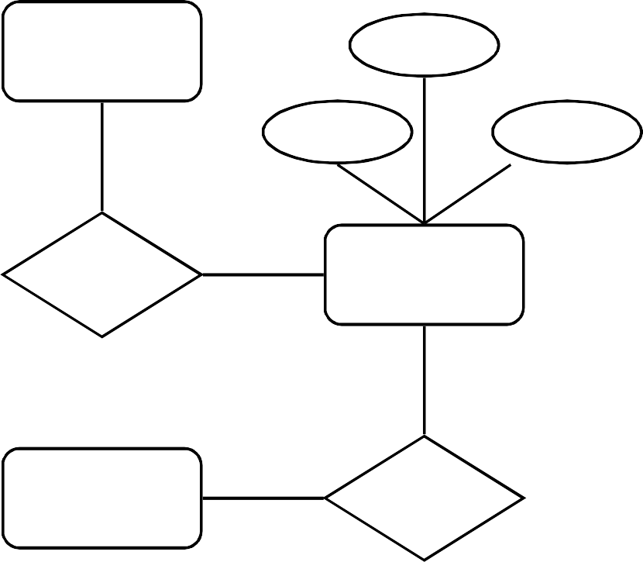
Example - ER Diagram
Example
In a University database
we might have entities for Students, Modules and Lecturers.
Students might have attributes such as their ID, Name, and Course, and could have relationships with Modules (enrolment) and Lecturers (tutor/tutee)
Lecturer
ID
Name
Course
Tutors
Student
Module
Studies

Slide 8
PROBLEM STATEMENT
8

Slide 9
Example COMPANY Database
We need to create a
Database schema design based on the following (simplified) requirements of the COMPANY Database:
9

Slide 10
COMPANY Database - DEPARTMENT
The company is organized into DEPARTMENTs.
Each department has a name, number and an employee who manages the department.
We keep track of the start date of the department manager.
A department may have several locations.

Slide 11
COMPANY Database - PROJECT
Each department controls a number of PROJECTs.
Each project has a unique name, unique number and is located at a single location.

Slide 12
COMPANY Database - EMPLOYEE
We store each EMPLOYEE’s social security number, address, salary, sex, and birthdate.
Each employee works for one department but may
work on several projects.
We keep track of the number of hours per week that an employee currently works on each project.
We also keep track of the direct supervisor of each employee.

Slide 13
COMPANY Database - DEPENDENT
Each employee may have a number of
DEPENDENTs.
For each dependent,
we keep track of their name, sex, birthdate, and relationship to the employee.

Slide 14
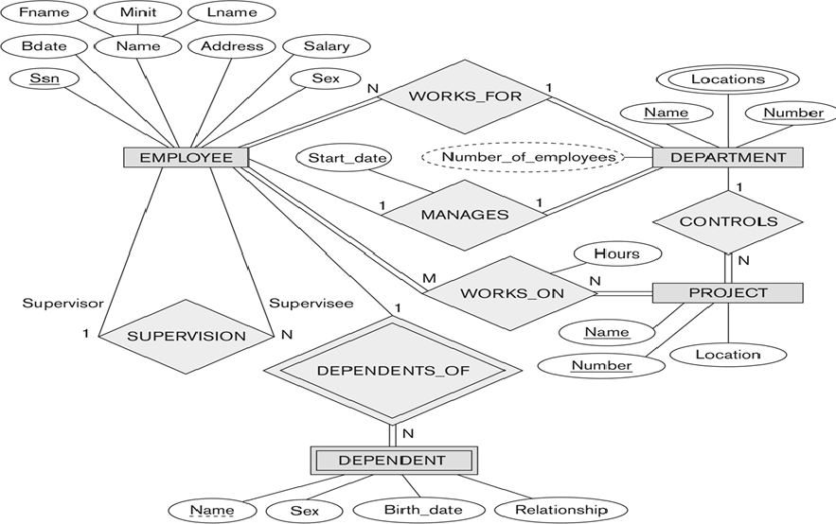

Slide 15
ER Model Concepts

Slide 16
ER Model Concepts - Entity
Entities
Entities are specific objects or things in the mini-world that are represented in the database.
Object
Physical Existence
Conceptual Existence
Examples:
Person: PROFESSOR, STUDENT
Place: STORE, UNIVERSITY
Object: MACHINE, BUILDING
Event: SALE, REGISTRATION
Concept: ACCOUNT, COURSE
Professor
Student

Slide 17
ER Model Concepts - Attributes
Attributes
Attributes are properties used to describe an entity.
Example
EMPLOYEE entity may have the attributes
Name,
SSN,
ID
Address,
Sex,
BirthDate
Name
Course
Student

Slide 18
ER Model Concepts
A specific entity will have a value for each of its attributes.
For example a specific employee entity may have
Name='John Smith',
SSN='123456789',
Address ='731, Fondren, Houston, TX',
Sex='M',
BirthDate='09-JAN-55‘
Each attribute has a value set (or data type) associated with it – e.g. integer, string, subrange, enumerated type.

Slide 19
Types of Attributes

Slide 20
Simple vs Composite
Simple
Each entity has a single atomic value for the attribute.
For example, SSN or Sex.
Composite
The attribute
may be composed of several
components.
For example:
Address(Apt#, House#, Street, City, State, ZipCode, Country), or
Name(FirstName, MiddleName, LastName).
Composition may form a hierarchy where some components are themselves composite.

Slide 21
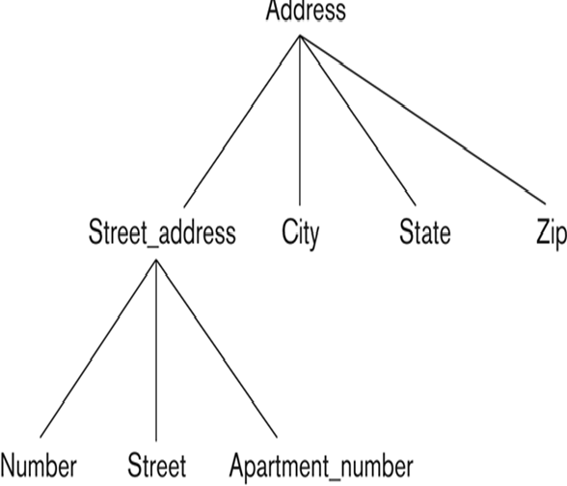

Example of a composite attribute

Slide 22

Single vs Multivalued
Single Valued
Most attributes have a single value for a particular entity; such attributes are called single-valued
For example,
Age
Multi-valued
An entity may have multiple values for that attribute.
For example, Color of a CAR or Degrees of a STUDENT.
Denoted as {Color} or {Degrees}.
lower and upper bound

Slide 23
Stored vs Derived
Date of birth -> Age

Slide 24
NULL Values
Apartment_number
College_degrees
NULL
Missing – Height of a person
Unknown – Land line number

Slide 25
Complex Attributes
In general, composite and multi-valued attributes may be nested arbitrarily to any number of levels, although this is rare.
For example, PreviousDegrees of a STUDENT is a composite multi-valued attribute denoted by
{PreviousDegrees (College, Year, Degree, Field)}
Multiple PreviousDegrees values can exist
Each has four subcomponent attributes:
College, Year, Degree, Field

Slide 26

Overview of Database Design Process
Example Database Application (COMPANY)
Employee
Department
Project
Dependent
ER Model Concepts
Entities and Attributes
Types

Slide 27


